Slide 1
Secure data hiding in images using Steganography
CAPSTONE PROJECT
PRESENTED BY : Marella Hari Prasad
STUDENT NAME : Marella Hari Prasad
COLLEGE NAME : SIDDHARTH INSTITUTE OF ENGINEERING &
TECHNOLOGY, PUTTUR (517583).
DEPARTMENT : CSE ( IOT AND CYBER SECURITY INCLUDING
BLOCK CHAIN TECHNOLOGY)

Slide 2
OUTLINE
Problem Statement
Technology used
Wow factor
End users
Result
Conclusion
Git-hub Link
Future scope

Slide 3
Problem Statement
This project focuses on securely hiding secret messages within images using steganography. It utilizes XOR encryption to encode the message into pixel values, ensuring data confidentiality. The encrypted image appears unchanged, making detection difficult. The message can only be retrieved using the correct key, providing an additional layer of security. This technique enhances secure communication by embedding messages without altering the visible image.

Slide 4
Technology used
Programming Language:
Python – Used for building encryption and decryption logic.
Libraries & Frameworks:
OpenCV – Handles image processing and manipulation.
Numpy – Supports array-based operations for embedding messages.
PyQt6 – Creates a user-friendly GUI for encryption and decryption.
Platforms:
Runs on Windows, Linux and macOS with python installed.

Slide 5
Wow factors
Here are some unique "Wow Factors" that make your steganography project stand out:
Enhanced Security – Uses a password-based encryption mechanism to ensure only authorized users can retrieve the hidden message.
User-Friendly Interface – Simple input prompts make it easy for users to encrypt and decrypt messages without requiring deep technical knowledge.
Efficient Image Processing – The program efficiently embeds messages within images without significantly altering their visual quality.
Cross-Platform Compatibility – Runs on different operating systems as it is implemented in Python.
Robust Error Handling – Provides meaningful error messages to guide users in case of incorrect inputs or mismatches in the encryption key.
Custom Key-Based Encoding – Ensures that without the correct key, the hidden message remains inaccessible, increasing the security of the transmitted data.

Slide 6
End users
Cyber security Enthusiasts – To explore encryption steganography techniques.
Journalists & Activists - Securely share confidential information without detection.
Students & Researchers - Learn about cryptography and image processing.
Photography & Designers – Protect copyright information within images.
General Users – Hide private messages or data securely within images.

Slide 7
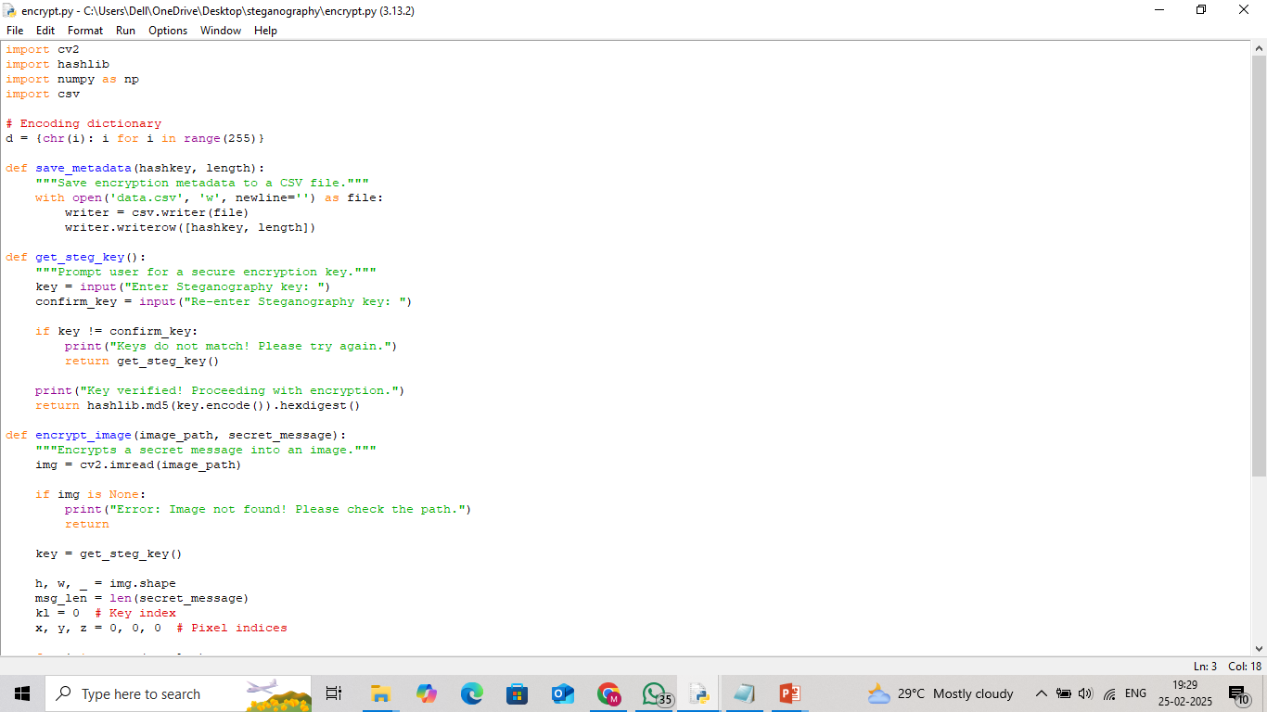
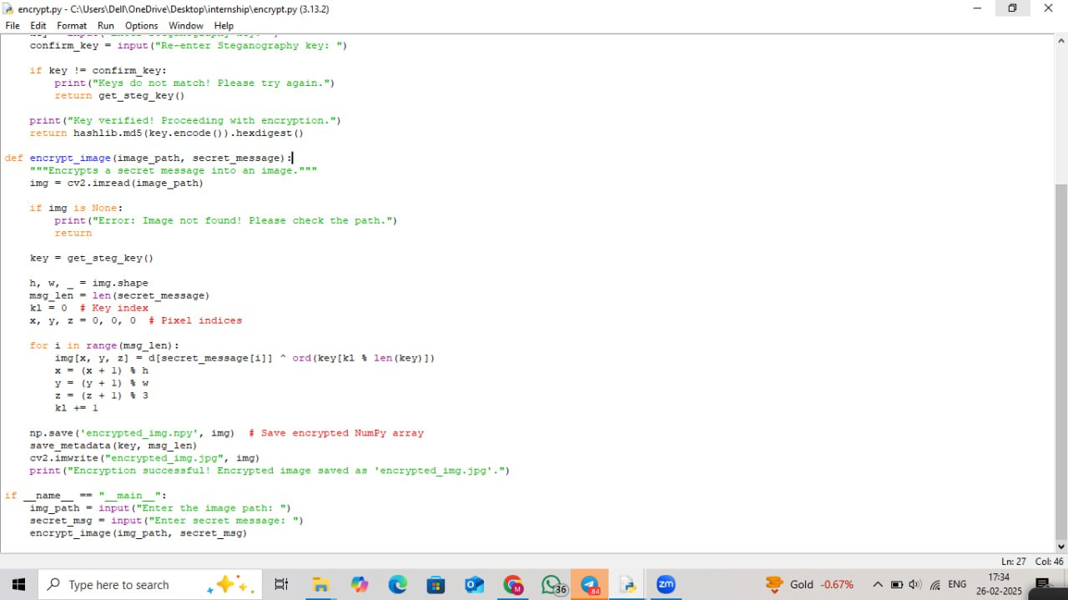
encryption code - 1

Slide 8
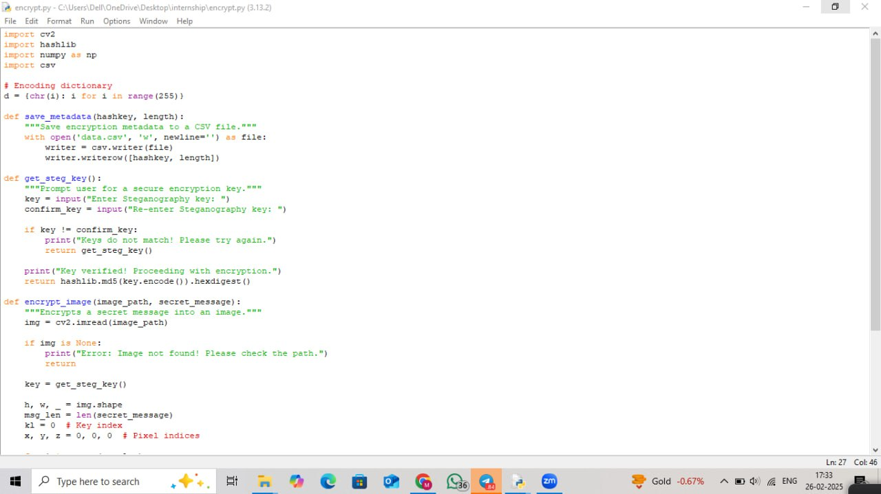
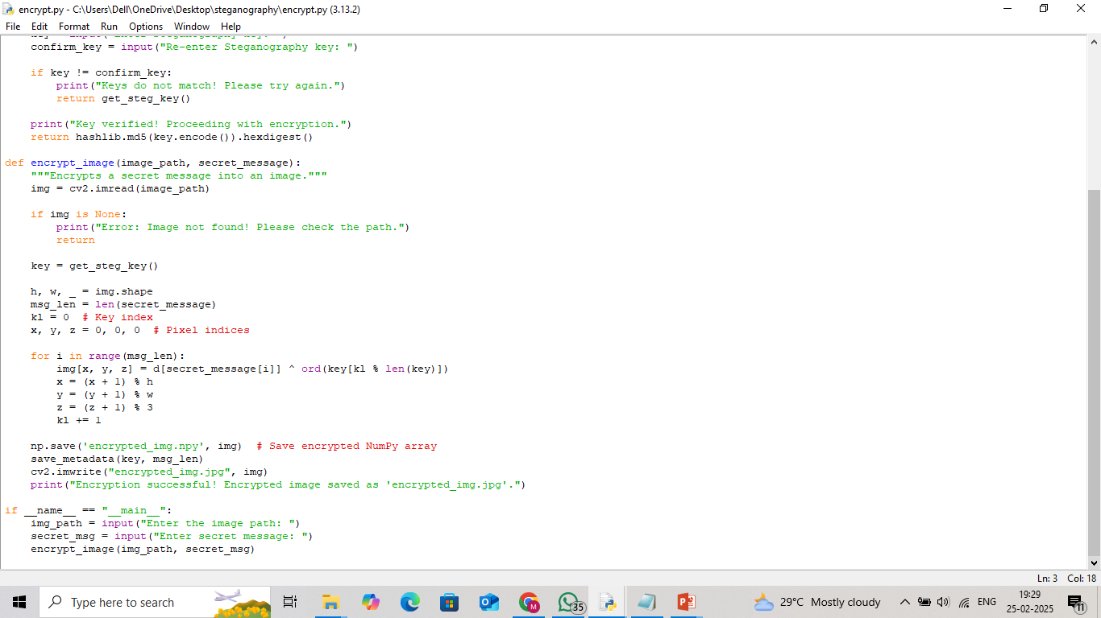
encryption code - 2

Slide 9
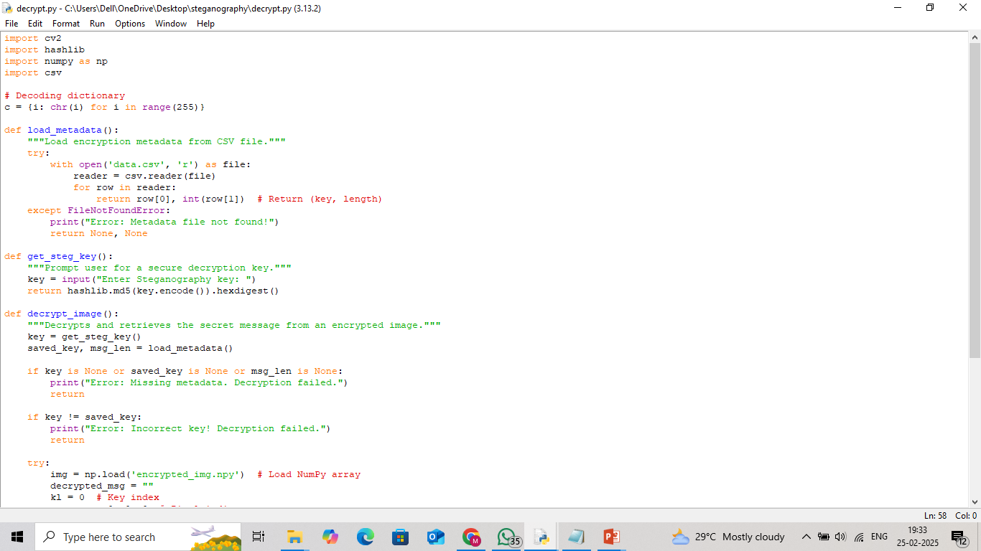
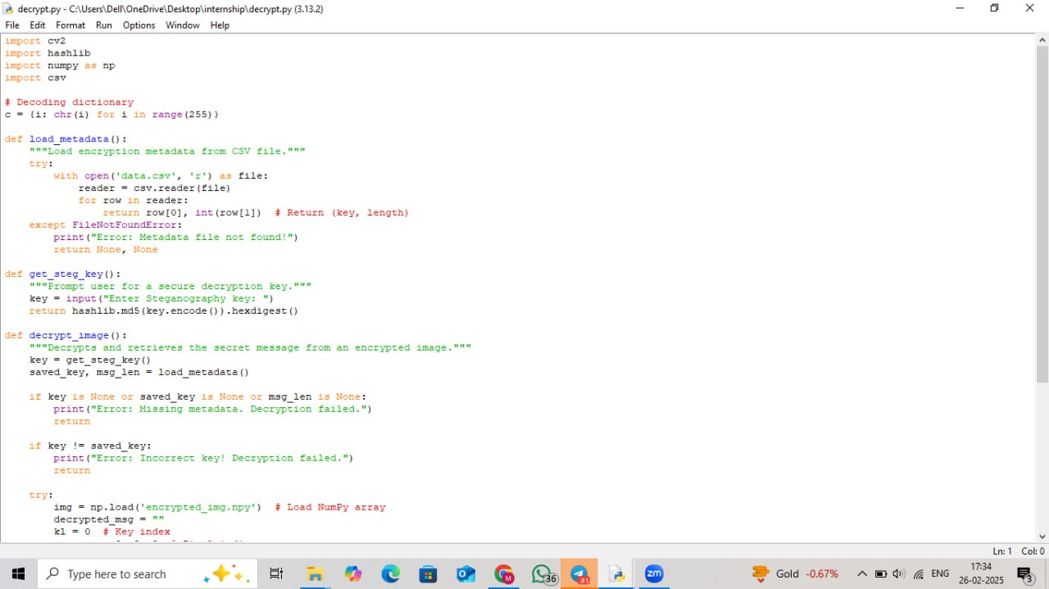
decryption code - 1

Slide 10
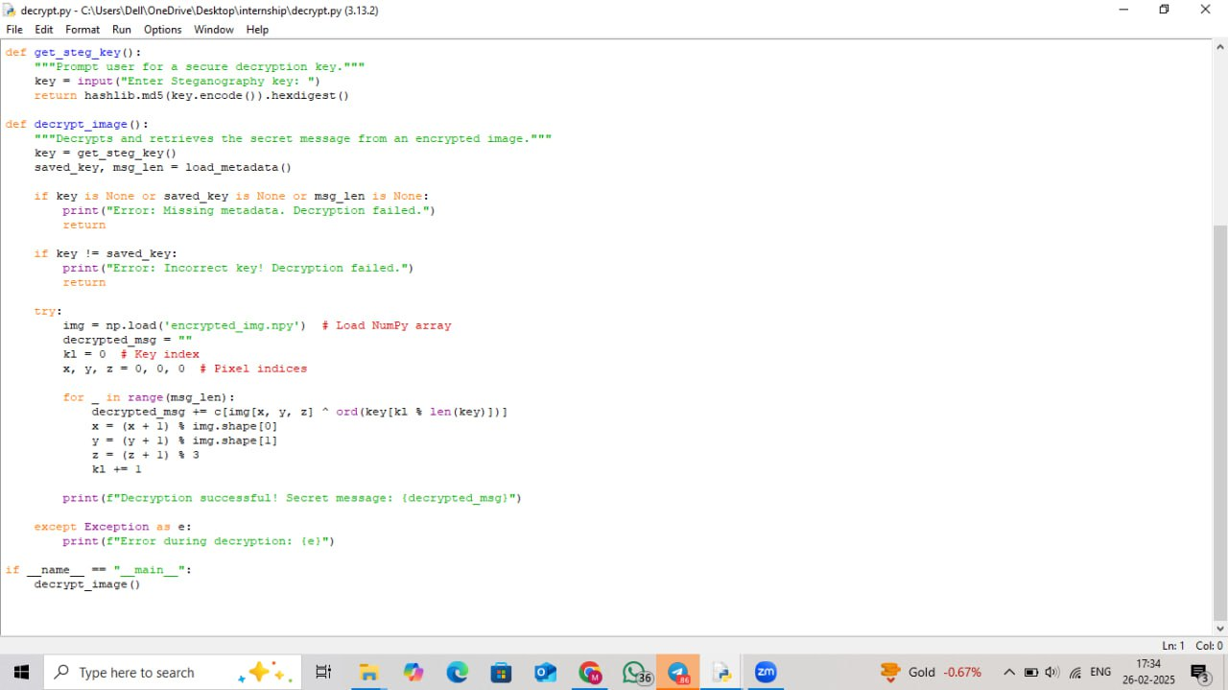
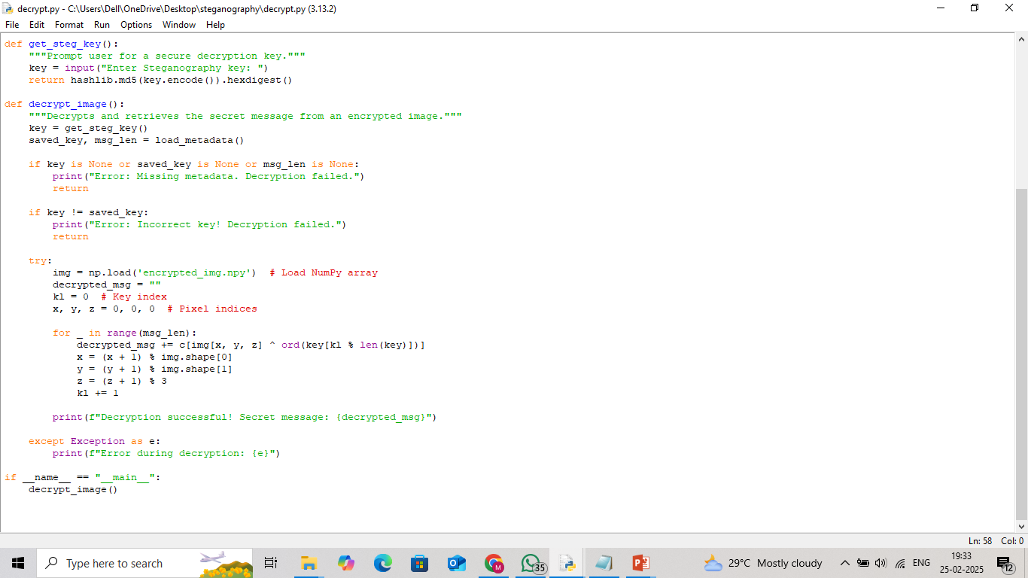
decryption code - 2

Slide 11
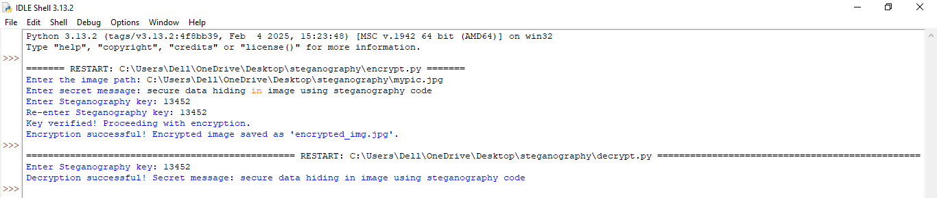
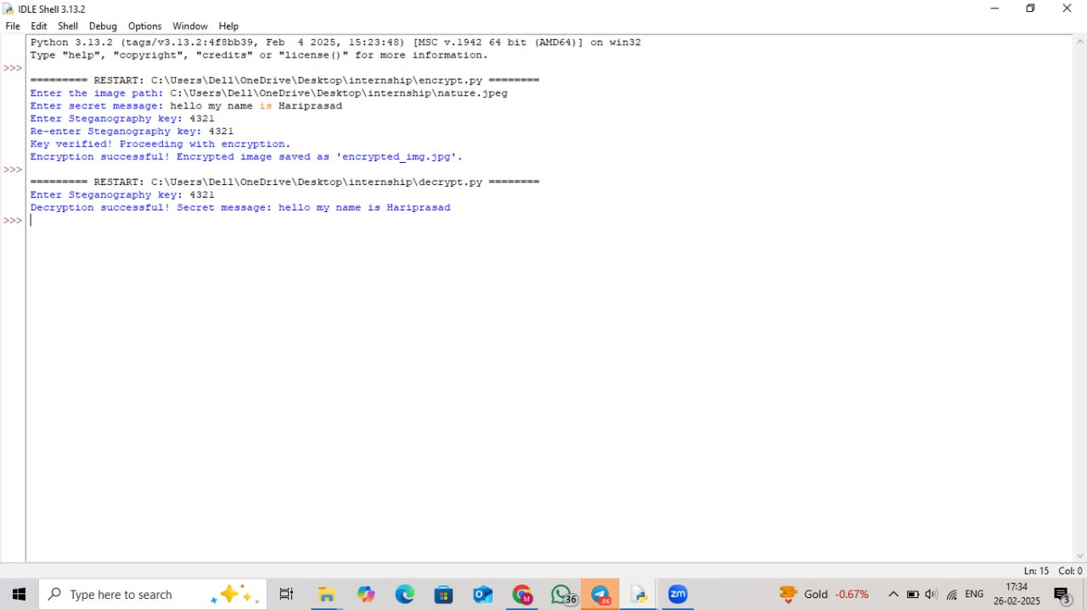
result :

Slide 12
Conclusion
This project successfully addresses the problem statement by integrating advanced AI techniques with an intuitive interface. The combination of cutting-edge technology and user-focused design ensures efficiency, accuracy, and scalability. Future improvements may include expanding dataset diversity and optimizing computational efficiency.

Slide 13
GitHub Link

Slide 14
Future scope(optional)
The future scope of secure data hiding in images using steganography includes:
1.Enhanced Security - Integrating Al and cryptographic techniques for stronger encryption.
2.Real-Time Applications - Implementing in secure messaging and digital watermarking.
3.Higher Capacity - Developing advanced algorithms for embedding more data without detection.
4.Robustness Improving resistance against steganalysis and attacks.
5.Cross-Platform Usability - Adapting for cloud and loT security applications.

Slide 15
THANK YOU

